Slide 1
CSE4204 LAB-6: Working with Models in Three.js

Slide 2
Download the materials at: rb.gy/i3o8c6

Slide 3
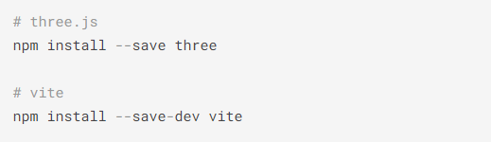

Don’t Forget to Run it on a Server
Run these commands
Finally run the server

Slide 4
Why 3D modeling is Important?
Modeling is the process of creating 3D objects
3D models provide a visual representation that is often more intuitive than traditional 2D representations.
Provides a more realistic and immersive user experience.
Models are integral to creating interactive elements
Once the models are obtained, we can transform them into the correct location and space

Slide 5
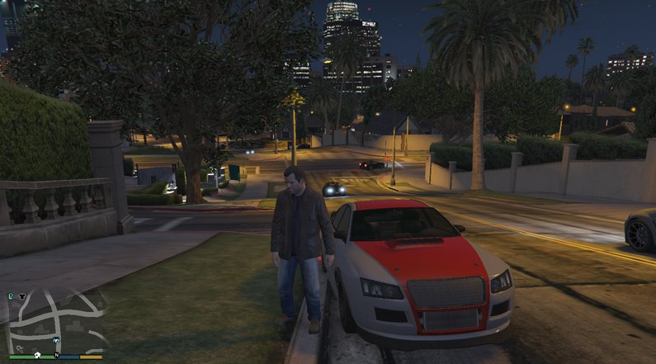

Slide 6
Working with Geometries in three.js
Three.js provides a variety of built-in geometries that serve as the foundation for 3D objects.
Some basic geometries provided by three.js are BoxGeometry, SphereGeometry, PlaneGeometry, and more
These geometries are simple shapes that serve as building blocks for more complex structures.
These geometris can be grouped together to create a more complex shape

Slide 7
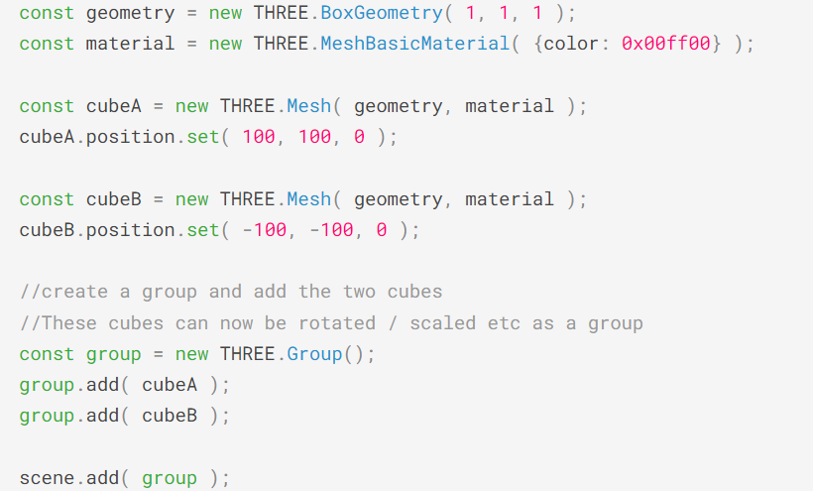
Grouping Geometries
Sample code snippet for grouping geometries

Slide 8
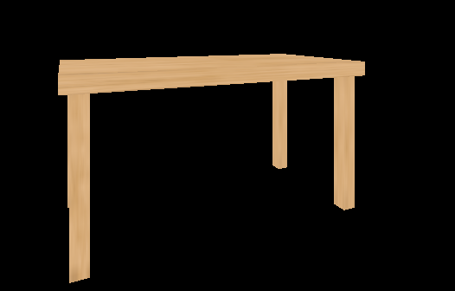
table.js

Slide 9
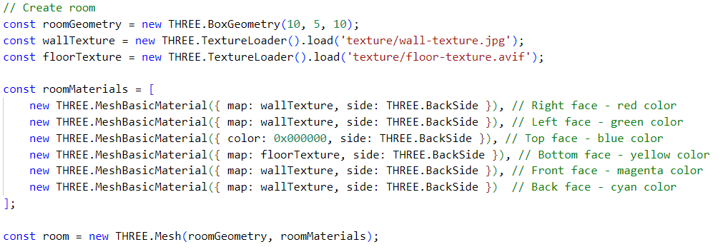
Applying Different textures in Faces
Sample code for applying different textures in different faces

Slide 10
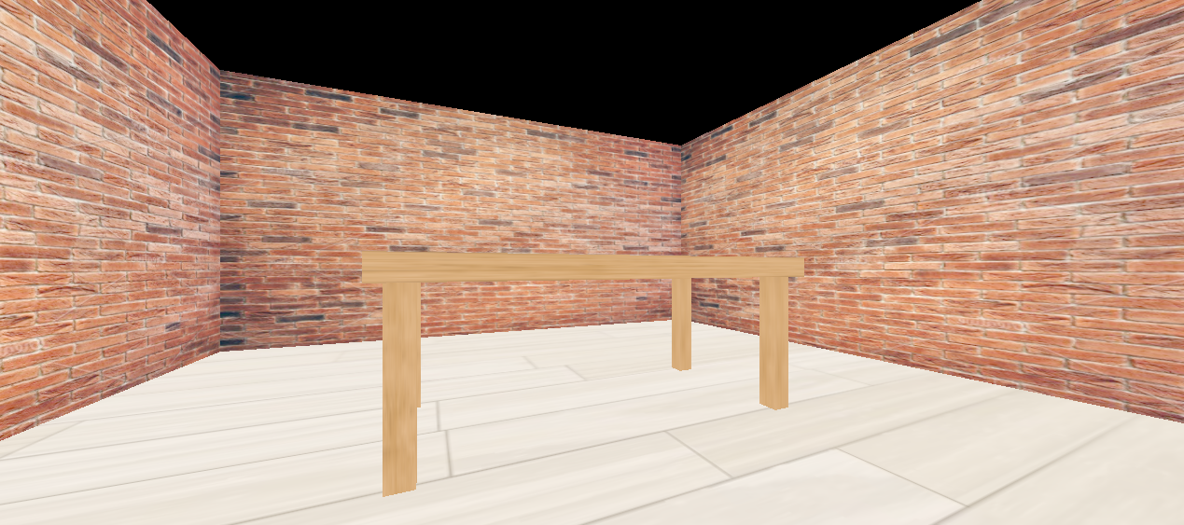
table-scene.js

Slide 11
Loading External Models
3D models are available in hundreds of file formats such as .gltf, .obj, .fbx etc.
three.js provides many loaders to load external models with different formats
All the loader files can be found here
three.js recommends using .gltf formats due to faster transmission and loading

Slide 12
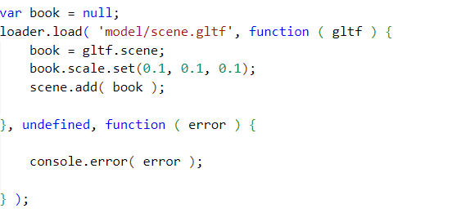
Loading External Models
Sample code for loading a .gltf model

Slide 13
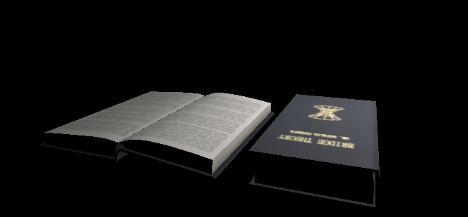
book-model.js

Slide 14
Combining Everything
Table, Room and Book

Slide 15
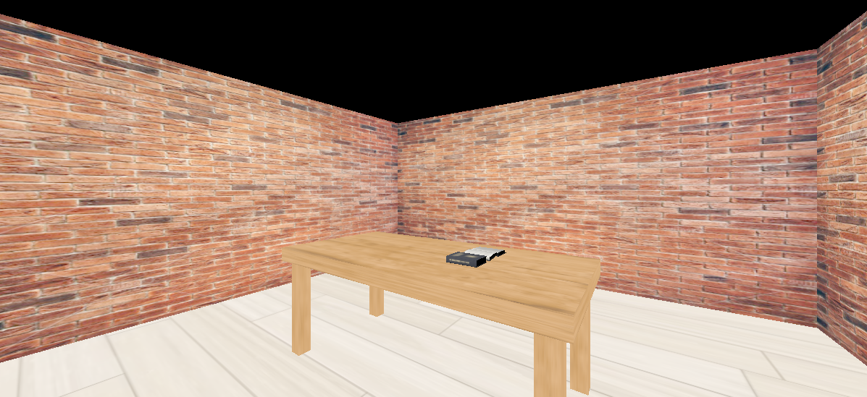
table-book-scene.js

Slide 16
Thanks
Source: https://threejs.org/

